Slide 1

Nebulark RPG
By Reagan Zierke

Slide 2
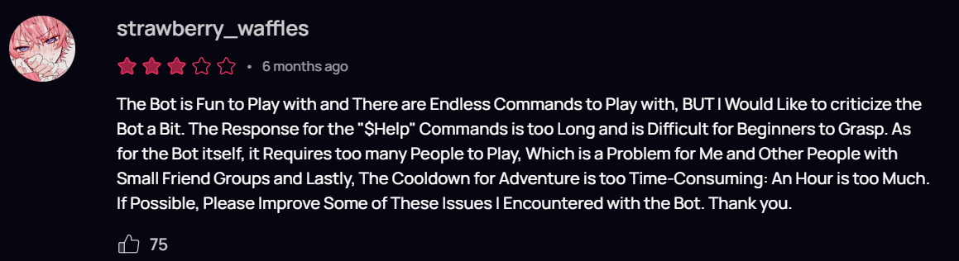
The Problem
Discord servers are more fun with bots, especially interactive bots such as Idle RPG.
BUT
Old Bot Complicated
Old Bot Not Up To Date

Slide 3
The Solution
Nebulark RPG is a space themed Idle RPG bot.
It addresses some concerns of the old such as
Up To Date
Easier To Learn
Better For Small Groups
Quicker Progression

Slide 4
Demo
Notes:
In Order to showcase:
/help
/gamble help
/gamble slots
/adventure list
/adventure start explore earth
/adventure status
Continue and do part 2 later

Slide 5
But How Does It Function?

Slide 6
Technologies
Nebulark RPG utilizes the following:
Backend:
Django Rest Framework
SQLite3 Database
Frontend:
Discord App
App (slash) Commands
Embed Styling

Slide 7
Steps For A Command
User calls a command through Discord
Command connects to API
APIView confirms a Discord ID is present
Serializer is called for validation
If serializer is valid, logic called to update database as needed
JSON returned to frontend
Frontend displays embed with related data

Slide 8
Demo P2
Notes:
/adventure status
/user profile
/user level_up

Slide 9
Problem
Solution
Prefix commands are outdated.
Slash commands
don’t automatically
refresh.
Utilize slash commands.
Write admin commands that allow me to sync the command tree at will.

Slide 10
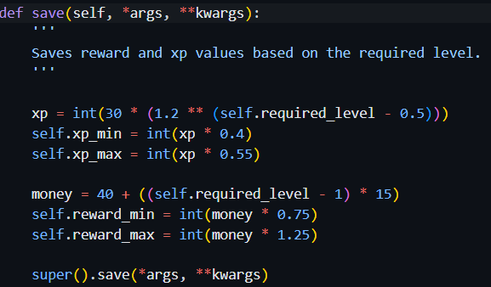
Problem
Solution
XP and Reward
Scaling
Instead of setting a constant for each adventure, write a save method on the adventure that sets it based on the level input.

Slide 11
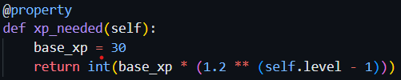
Problem
Solution
How can I scale the amount of XP to
level up without
making it too
difficult?
Write a class property based on the user’s
current level.

Slide 12
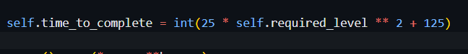
Problem
Solution
How can I scale the amount of time it
takes for an
adventure?
Add on to the save method for XP and
reward determination for an adventure.

Slide 13
Future
Add interactive adventures
Shops
Stats
More adventures
Trading
Gear
Website Frontend w/ Bonuses
Deployment
More

Slide 14
Questions
Notes:
/adventure status
/user profile
/user level_up

